Slide 1


Site 16 interactions comments- NSP13
Heba Agha
9-22-2021

Slide 2
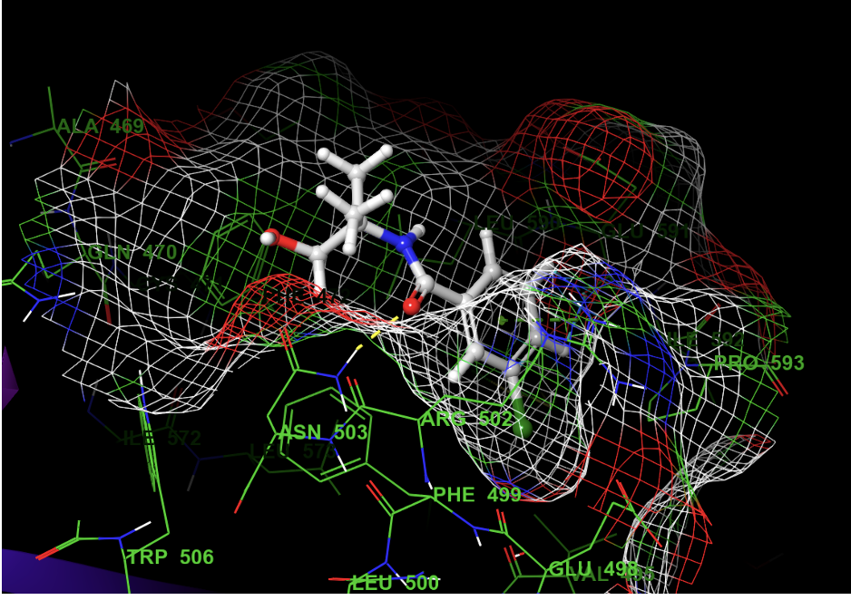
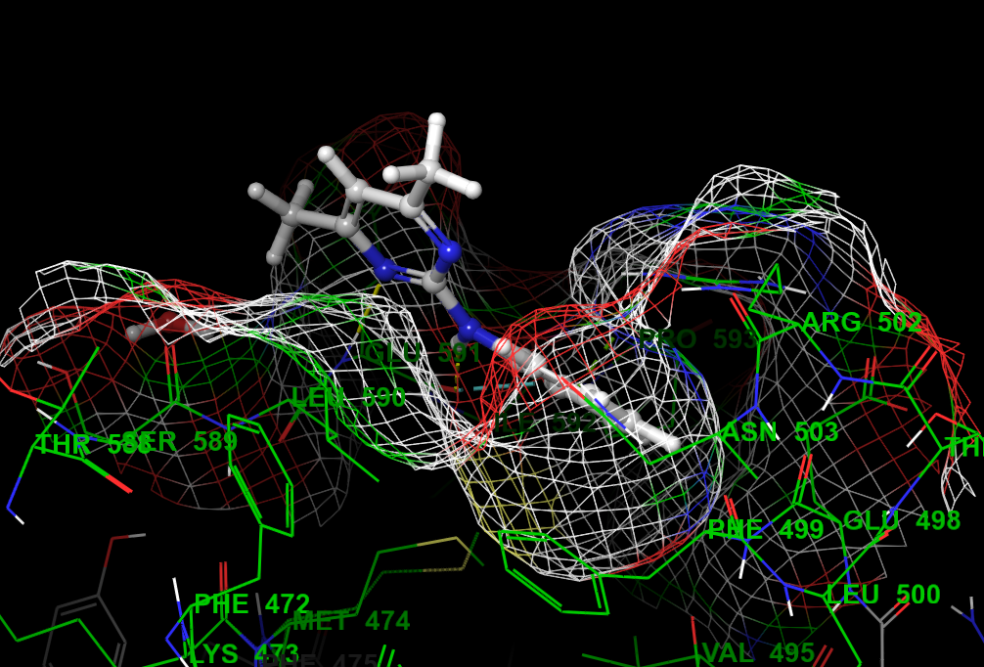
Fragment 645 Fragment 524
The orientation of the phenyl ring with fragment 524 is different from the orientation with fragment 645. For fragment 645, the ring go deep in the pocket and a chlorine atom could be involved in interaction with Val495. While with fragment 524, it did not go deep in the pocket. It could be due to 524 has only one carbon linker to pyrimidine and the pyrimidine ring is involved in a hydrogen bond interaction with the pocket. I think it is better to have at least 2 carbon linker between two aromatic rings.

Slide 3
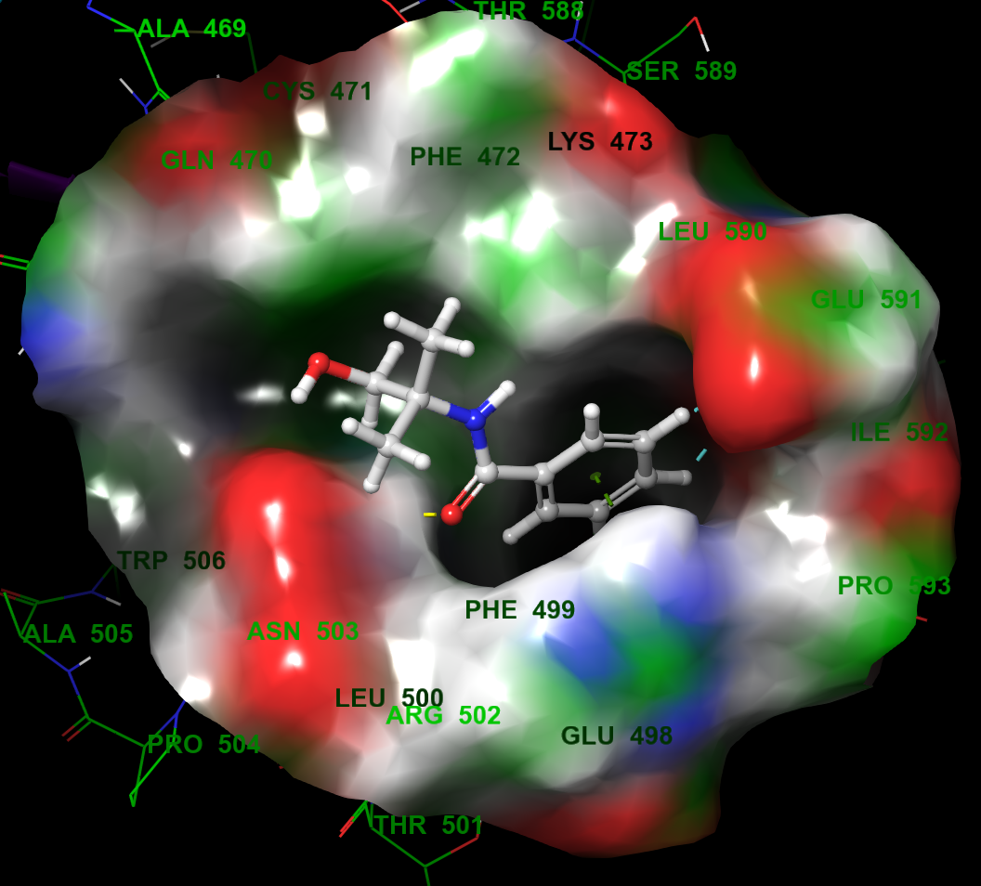
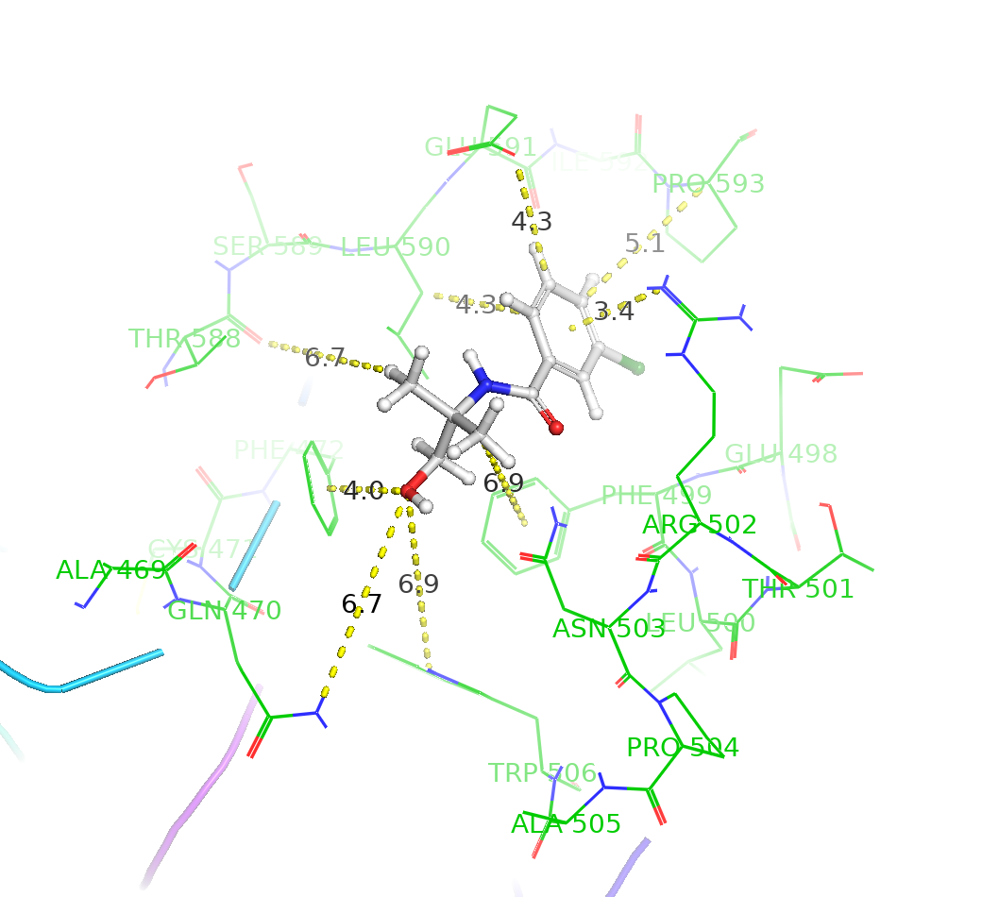
Measuring the distance from PyMol for possible fragment growing.
Fragment 645: The pocket could tolerate a second ring (eg: thiazole, oxazole) as a replacement of the dimethyl group. For fragment growing, it could be a good idea to have two aromatic rings connect with the amide bond. The second ring could have a polar group that might be involved in hydrogen bond interaction with Asn 503.

Slide 4
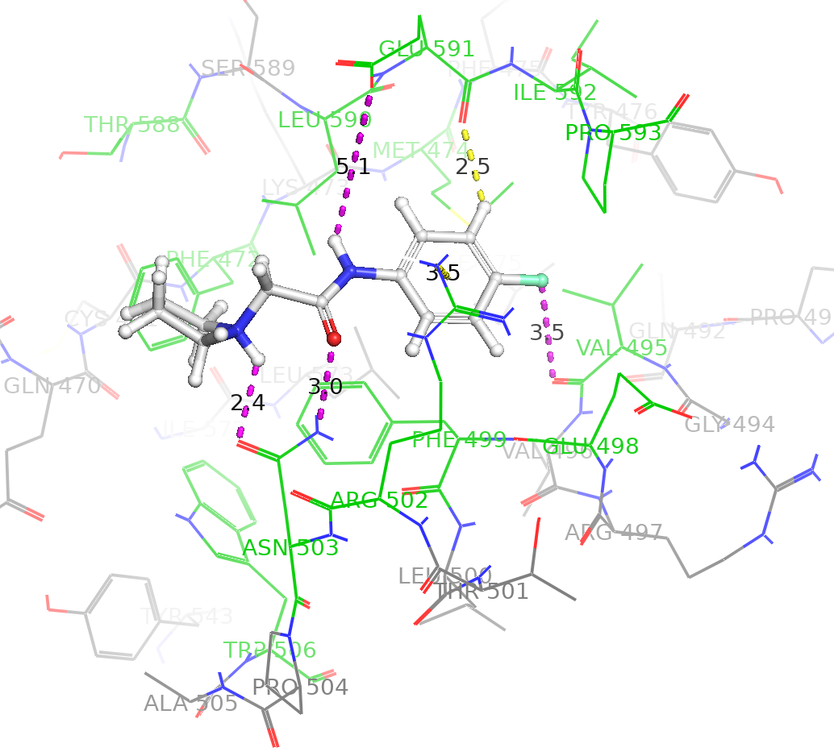
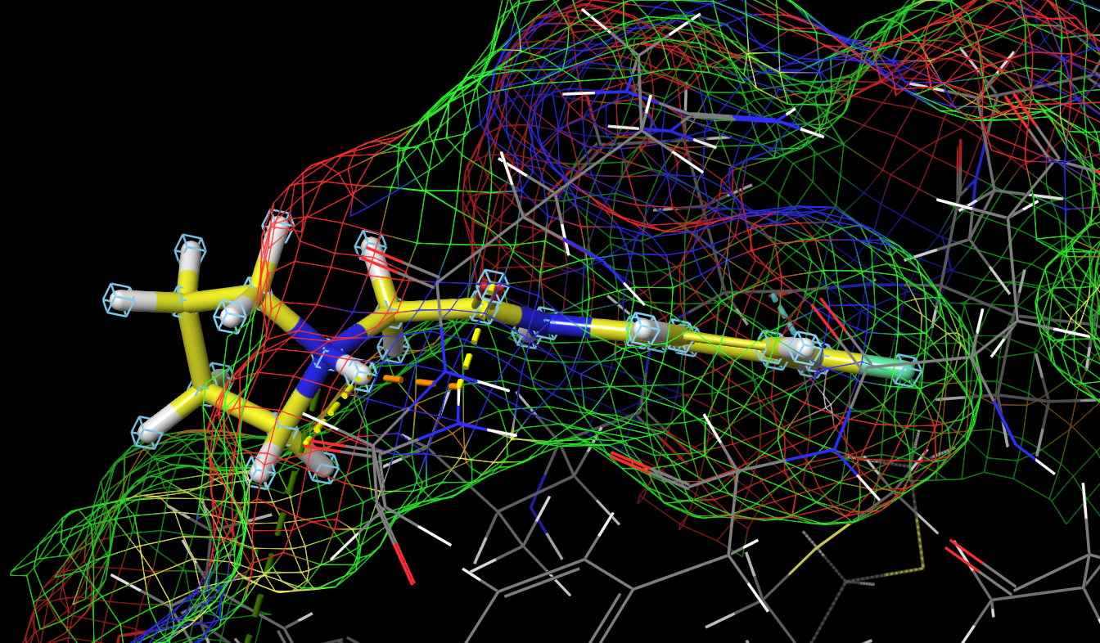
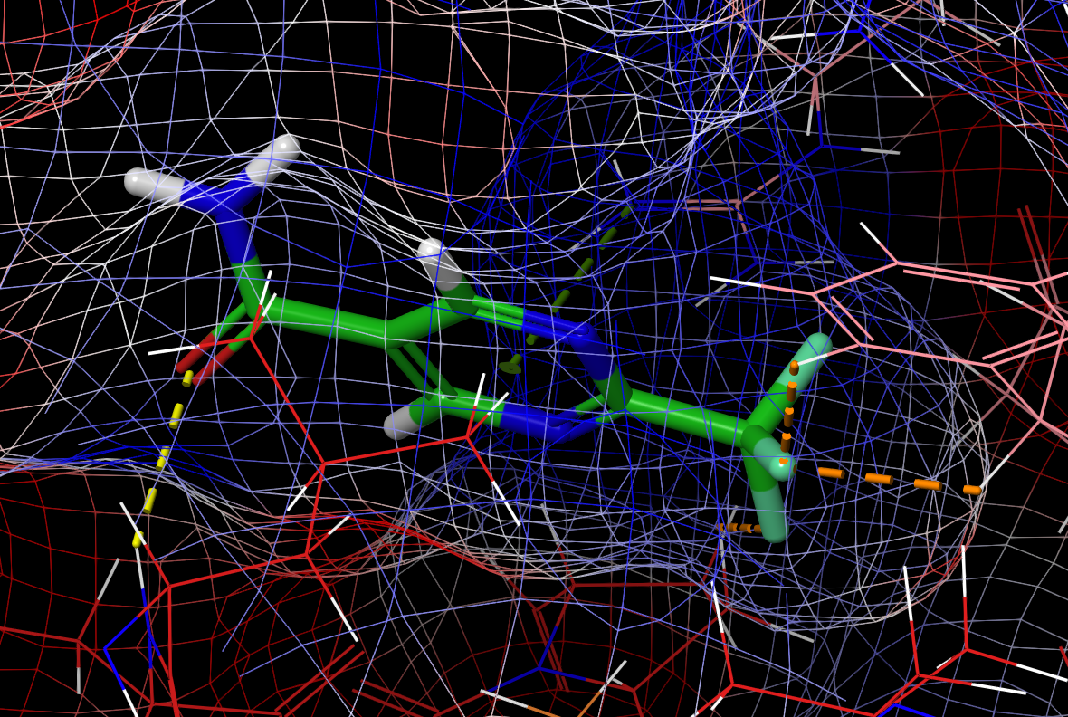
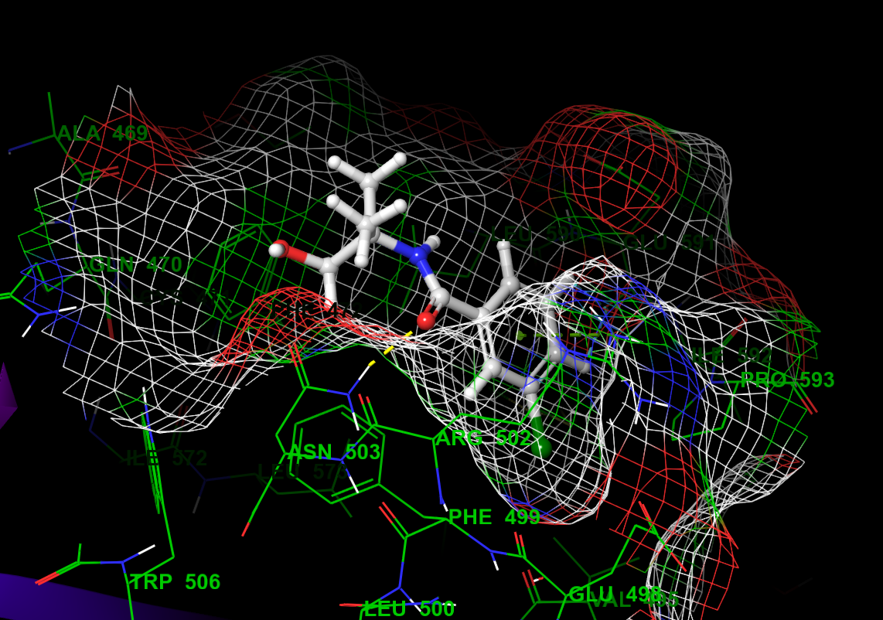
Meta and para substitutions with polar groups, or halide is expected to form hydrogen bond with Val495, Glu498, and Glu 591 and could be worthy.
CF3 is bulky and resulted in the pyridine ring move to the left as in fragment 330 and the NH has no interaction.
Consider to have amide or a reversed amide as in fragment 451 (NH is directly connected to phenyl ring). Also, nitrogen atom one carbon away from the amide in fragment 451 showed interaction with Asn503.
Fragment 451
Fragment 451
Fragment 524
Fragment 330
Fragment 645

Slide 5
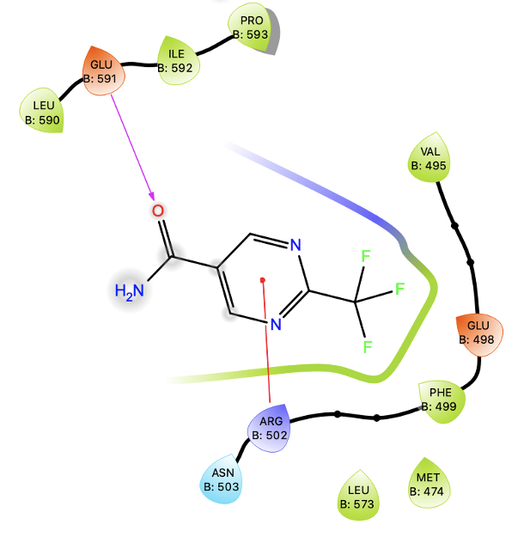
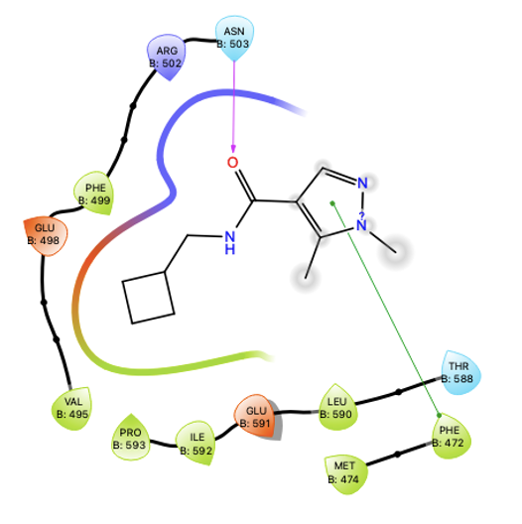
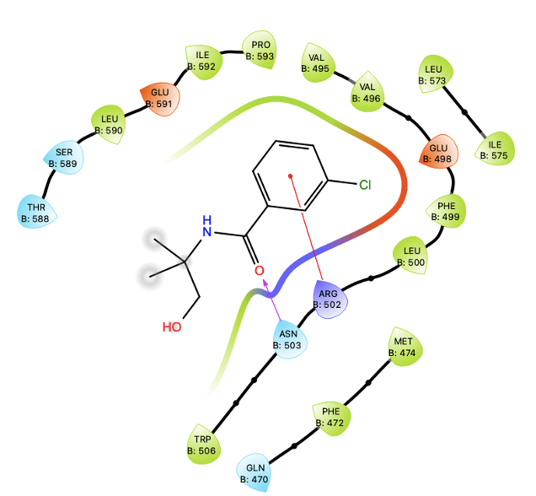
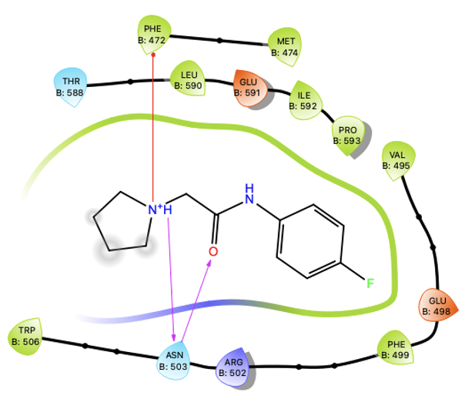
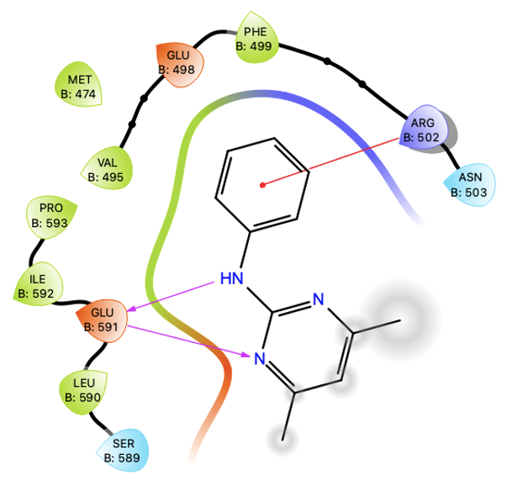
Fragment 330
Fragment 645
Fragment 420
Fragment 451
Fragment 524
- Interaction with the following residues:
Arg502, Glu591, Asn503, Phe 472.
- Other hydrophobic residues:
Val495, Pro593, Leu590

Slide 6
Hydrophobic with one polar atom at the end
5-membered aromatic ring with polar atom and methyl substitution
2-3 atom linker with carbonyl or NH
Aromatic or cyclic aliphatic with polar group
Fragment 645

Slide 7
Suggested pharmacophore

Slide 8
Site 16 Fragments

